Slide 1
Lexical Analysis - II

Slide 2
Input Buffer Pairs
Lexical analyzer needs to look ahead some symbols to identify tokens. An input-buffering scheme is used for this purpose.
Use a paired buffer of N characters each
Two pointers : 1. lexeme-beginning 2. forward
N-characters
N-characters
..
..
E
=
M
*
C
*
*
2
eof
forward
lexeme_beginning

Slide 3
Input Buffer Pairs
Code to advance forward pointer
if forward at end of first half of buffer then
reload second half;
forward = forward +1;
else if forward at end of second half of buffer then
reload first half;
move forward to the beginning of first half
else
forward = forward +1
Deficiency of Coding:
Except at the ends of the buffer halves, it requires two tests for each advance of the forward pointer.

Slide 4
Sentinels
Technique: Use “Sentinels” to reduce testing
Choose some character that occurs rarely in most inputs e.g. ‘eof’
N-characters
N-characters
..
..
E
=
M
*
eof
C
*
*
2
eof
eof
forward
lexeme_beginning
    forward = forward + 1;
    if forward ↑ == eof then
    if forward at end of first half buffer then
    read next N bytes into second half buffer
    forward = forward + 1
    else if forward at end of second half buffer then
    read next N bytes into first half buffer
    forward = forward + 1
    else
    terminate lexical analysis

Slide 5
Terminology
Alphabet (∑) : A character class
  A finite set of symbols (“characters”)
  Examples: ∑ = { 1, 0} : binary alphabet
  ∑ = { 1, 2, 3, 4, 5, 6 } : Alphabet on dice outcome
String : A Sentence or word
  Finite sequence of symbols derive from ∑
  Finite in length and length of s = |s|
  Example: abbadc
Empty String (ε)
  It is a special string of length zero, i.e. | ε | = 0
Language
  A set of strings over some fixed alphabet ∑
  Examples: L1 = { a, baa, bccb }, L2 = { }, L3 = {ε}
        L4 = {ε, ab, abab, ababab, abababab,... }

Slide 6
Terminology
Prefix ...of string s
  String obtained by removing zero or more trailing symbols
  For string s = hello, Prefixes: ε, h, he, hel, hell, hello
Suffix ...of string s
  String obtained by deleting zero or more of the leading symbols
  For string s = hello, Suffixes: hello, ello, llo, lo, o, ε
Substring ...of string s
  String obtained by deleting a prefix and a suffix
  For string s = hello, Substrings: ε. ell, hel, llo, hello, ….
  Every prefix or every suffix of s is a substring of s
  Not every substring of s is a prefix of suffix of s

Slide 7
Terminology
Proper prefix / suffix / substring ... of s
  String s₁ that is respectively prefix, suffix, or substring of s such that
  s₁ ≠ s and s₁ ≠ ε
Subsequence….of string s
  String formed by deleting zero or more not necessarily contiguous symbols
  For string s = hello, Subsequence: hll, eo, hlo, etc.

Slide 8
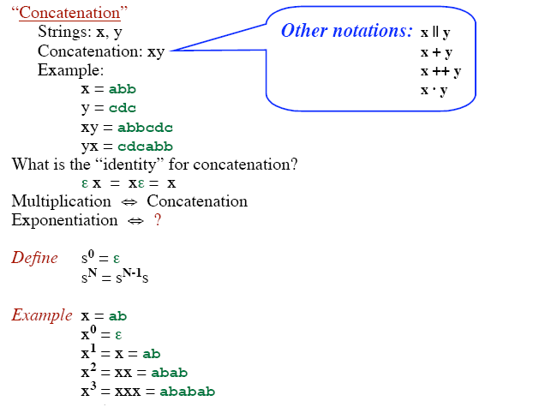
Terminology

Slide 9
Terminology
Language
  A set of strings over some alphabet ∑
  L = { ... }
  M = { ... }
Union of two languages
  L ∪ M = { s | s is in L or is in M }
  Example:
  L = { a, ab } and M = { c, dd }, then L ∪ M = { a, ab, c, dd }
Concatenation of two languages
  LM = { st | s is in L and t is in M }
  Example:
  L = { a, ab } and M = { c, dd }, then LM = { ac, add, abc, abdd }

Slide 10
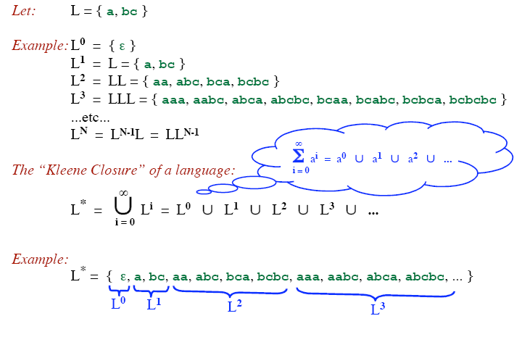
Kleene closure
Terminology
L* denotes “zero or more concatenations of” L

Slide 11
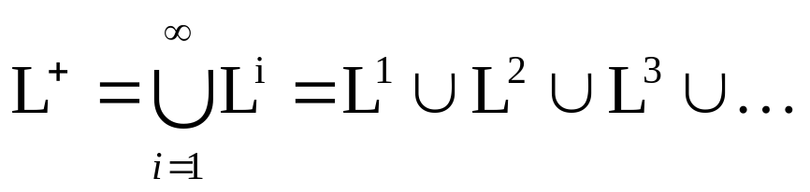
Positive closure
Terminology
Let: L = { a, bc }
Example: L⁰ = { ε }
      L¹ = L = { a, bc }
      L² = LL = { aa, abc, bca, bcbc }
      L³ = LLL = { aaa, aabc, abca, abcbc, bcaa, bcabc, bcbca, bcbcbc }
...etc...
L^{N} = L^{N-1}L = LL^{N-1}
The “Positive Closure” of a language:
Example:
L⁺ = { a, bc, aa, abc, bca, bcbc, aaa, aabc, abca, abcbc, ... }
L⁺ denotes “one or more concatenations of” L
L¹
L²
L³

Slide 12
Example
Let: L = { a, b, c, ..., z }
D = { 0, 1, 2, ..., 9 }
D⁺ = “The set of strings with one or more digits”
L ∪ D = “The set of all letters and digits (alphanumeric characters)”
LD = “The set of strings consisting of a letter followed by a digit”
L* = “The set of all strings of letters, including ε, the empty string”
( L ∪ D )* = “Sequences of zero or more letters and digits”
L ( ( L ∪ D )* ) = “Set of strings that start with a letter, followed by
zero or more letters and digits.”

Slide 13
Language and Regular Expressions
A Regular Expression is a set of rules/techniques for constructing sequences of symbols (strings) from an alphabet ∑.
Let Σ be an alphabet, r be a regular expression, then L(r) is the language that is characterized by the rules of r.
A language denoted by a regular expression is called regular set.
Example:
Let Σ = {a, b}. The regular expression a|b denotes the set {a, b}.
Regular expressions are an important notation for specifying patterns for tokens.

Slide 14
Rules for specifying Regular Expressions
Regular expressions over alphabet ∑
ε is a regular expression that denotes the set {ε}.
If a is a symbol (i.e., if a∈ ∑), then a is a regular expression that denotes the set {a}.
Suppose r and s are regular expressions denoting the languages L(r) and L(s). Then
  (r) | (s) is a regular expression denoting L(r) U L(s).
  (r)(s) is a regular expression denoting L(r)L(s).
  (r)* is a regular expression denoting (L(r))*.
  (r) is a regular expression denoting L(r).

Slide 15
How to “Scan” Regular Expressions
Precedence:
  ‘*’ → highest precedence.
  ‘.’ → middle precedence.
  ‘|’ → lowest precedence.
  Use ( ) to override these rules.
Examples:
  a b* = a (b*)
    If you want (a b)* you must use parentheses.
  a | b c = a | (b c)
    If you want (a | b) c you must use parentheses.
Concatenation and | are associative.
  (a b) c = a (b c) = a b c
  (a | b) | c = a | (b | c) = a | b | c
Example:
  b d | e f * | g a = (b d) | (e (f *)) | (g a)

Slide 16
Example
Let Σ = {a, b}
  The regular expression (a|b)(a|b) denotes {aa, ab, ba, bb}
  The regular expression a* denotes the set of all strings of zero or more a’s. i.e., {ε, a, aa, aaa, ….. }
  The regular expression (a|b)* denotes the set containing zero or more instances of an a or b.
  The regular expression a|a*b denotes the set containing the string a and all strings consisting of zero or more a’s followed by one b.

Slide 17
Equality vs Equivalence
Are these regular expressions equal?
    R = a a* (b | c)
    S = a* a (c | b)
... No!
Yet, they describe the same language.
L(R) = L(S)
“Equivalence” of regular expressions
If L(R) = L(S) then we say R ≅ S (“R is equivalent to S”)
From now on, we’ll just say R = S to mean R ≅ S

Slide 18
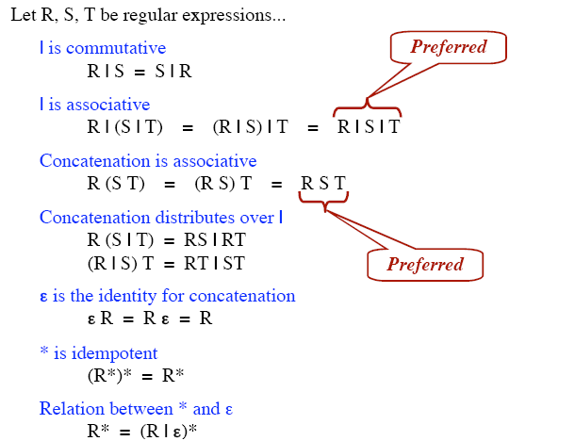
Algebraic law of regular expressions

Slide 19
Regular Definition
If Σ is an alphabet of basic symbols then a regular definition is a sequence of the following form:
d₁→r₁
d₂→r₂
……..
d_{n}→r_{n}
where
Each d_{i} is a distinct name such that d_{i} ∉ Σ and d_{i} ≠d_{j} where j ≠ i
Each r_{i} is a regular expression over Σ ∪ {d₁,d₂,…,d_{i-1})

Slide 20
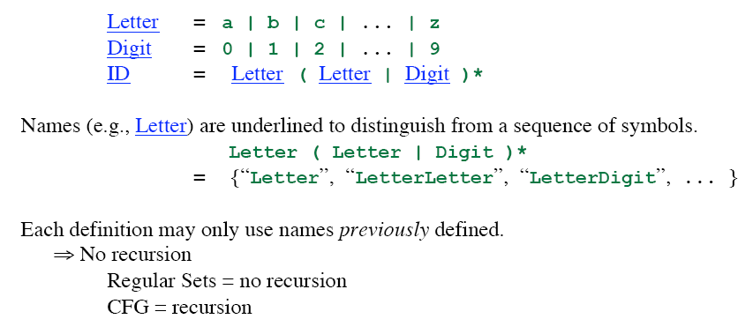
Regular Definition

Slide 21
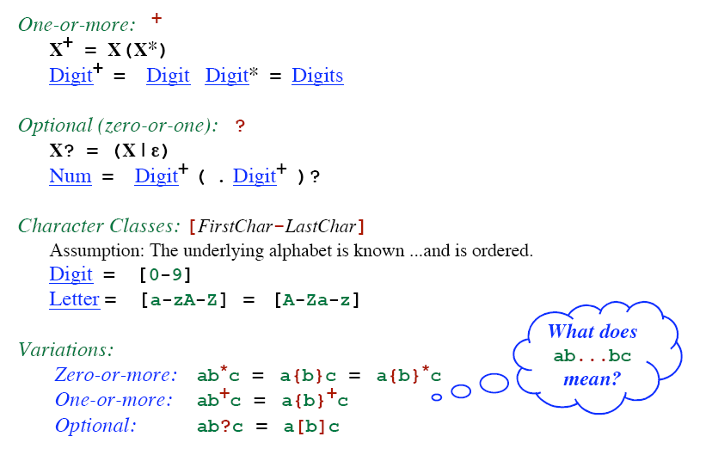
Notational Shorthand

